Slide 1
CS424 Visualization and Visual Analytics
Assignment - 2
TEAM - Chicagobulls
1. Surya Atkuri - satkur2
2. Vishal Goud Mogili - vmogil2
3. Hemanth Pokala - hpokal2
4. Vivek Kothuru - vkothu2

Slide 2

Dataset
Chicago Traffic Tracker - Congestion Estimates by Segments
Chicago Traffic Tracker Dataset is a collection of historical estimated congestion data for over 1000 traffic segments in Chicago.
Dataset comprises of 275 million rows and 22 columns of attributes.
The congestion estimates are generated every 10 minutes by continuously monitoring and analyzing GPS traces received from Chicago Transit Authority (CTA) buses.
Notes:
Few of the attributes in the dataset include: Time, Segement_id, street, speed, street, direction, bus_count, hour of the day, day of the week, latitude and longitude values etc.

Slide 3
Goals of the visualization
Understanding Traffic Patterns
Data-Driven Decision Making
Identifying Problematic Areas and providing a holistic view
Analyzing Seasonal Patterns
Evaluating the Impact of COVID-19
Notes:
Understanding Traffic Patterns: One of our primary goals is to gain a deep understanding of traffic patterns in Chicago, with a focus on congestion levels and how they vary over time.
Data-Driven Decision Making: Ultimately, our visualizations aim to facilitate data-driven decision-making, helping commuters and city planners optimize traffic flow, reduce congestion, and enhance urban mobility.
Identifying Problematic Areas and providing a holistic view: Our goal is to identify the most congested streets and traffic segments, providing a holistic view of traffic conditions, enabling a comprehensive analysis from different angles that gives us clear list of areas that require immediate attention and mitigation.
Analyzing Seasonal Patterns: We want to uncover seasonal variations in congestion to support planning for different times of the year and to understand the impact of external factors.
Evaluating the Impact of COVID-19: We also compare pre-COVID and post-COVID traffic data to evaluate the impact of the pandemic on traffic patterns.

Slide 4
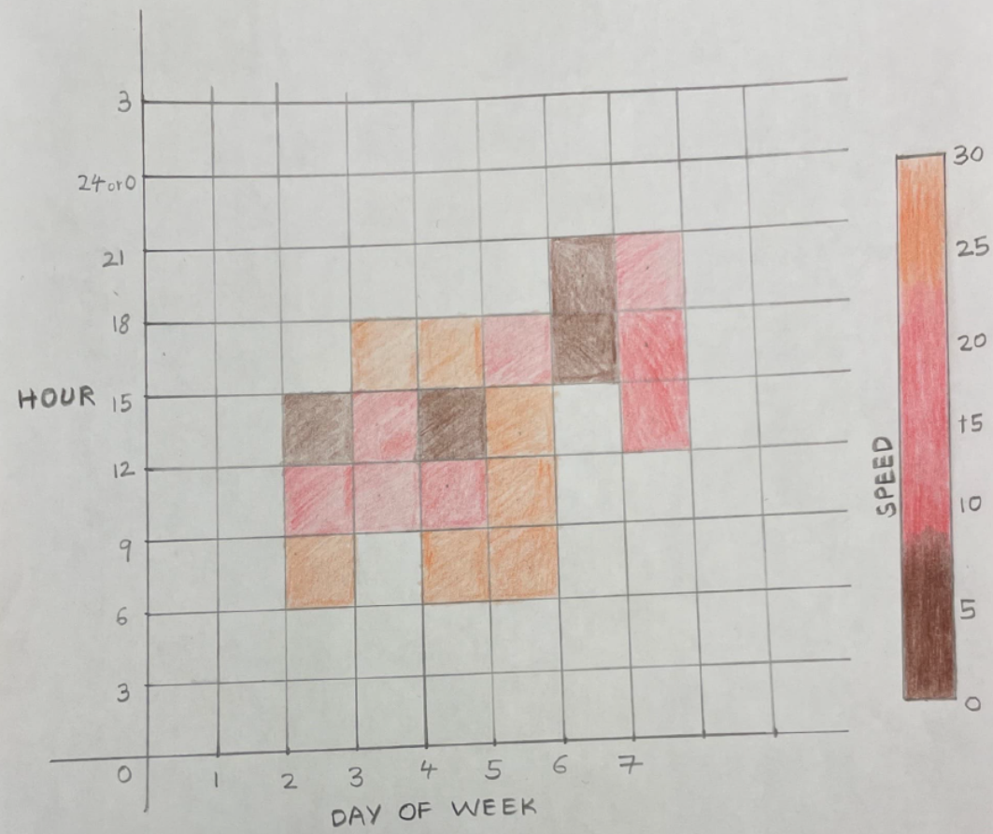
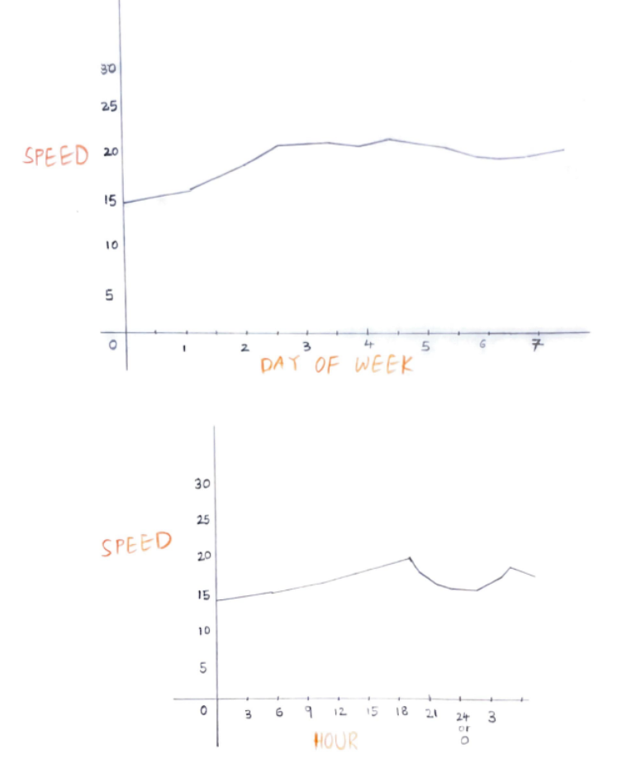
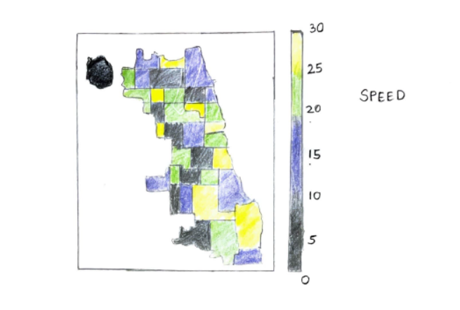
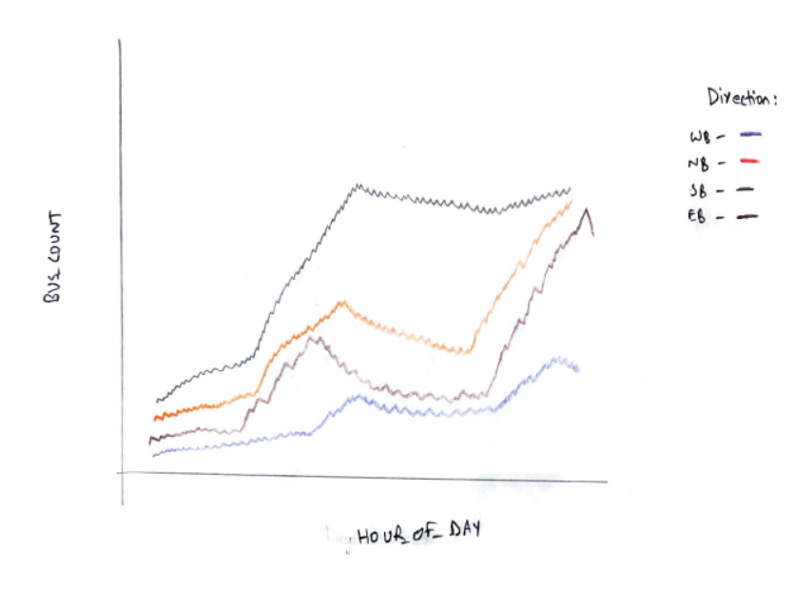
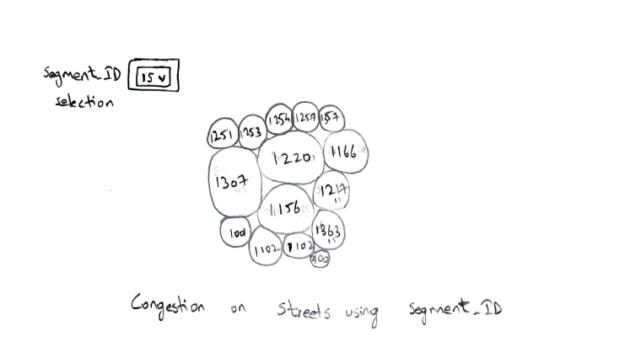
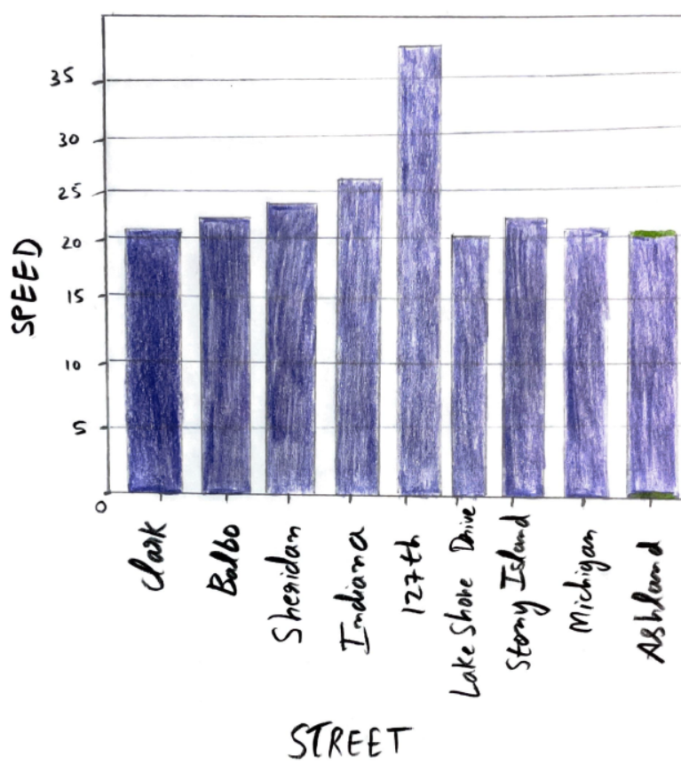
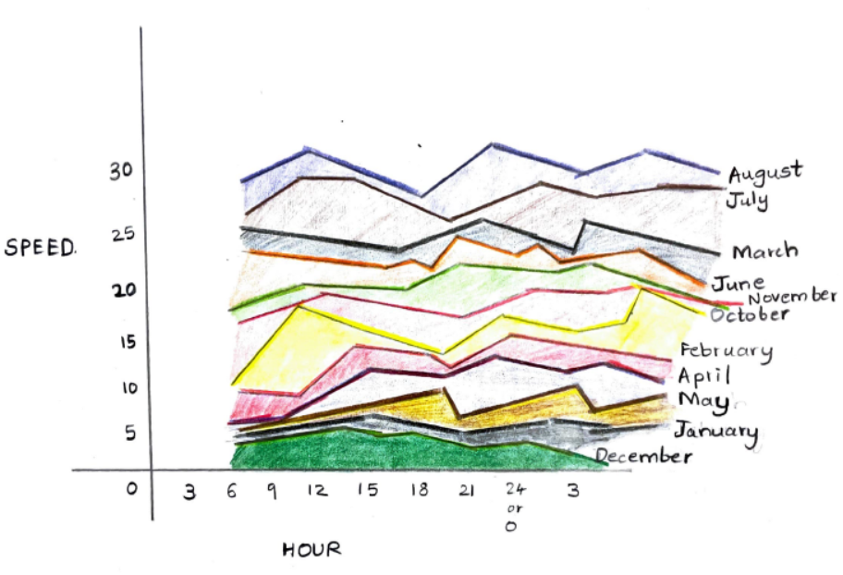
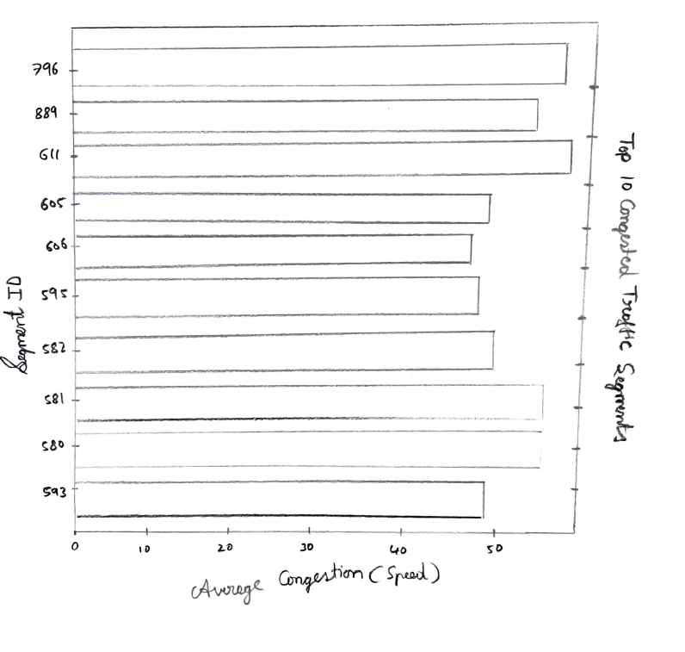
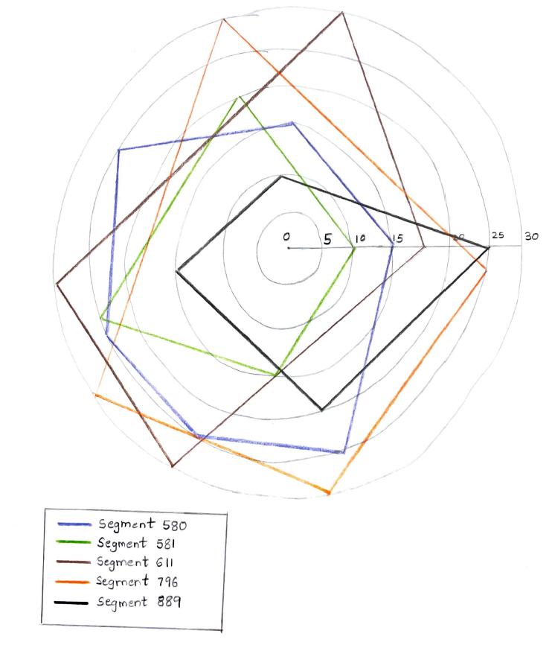
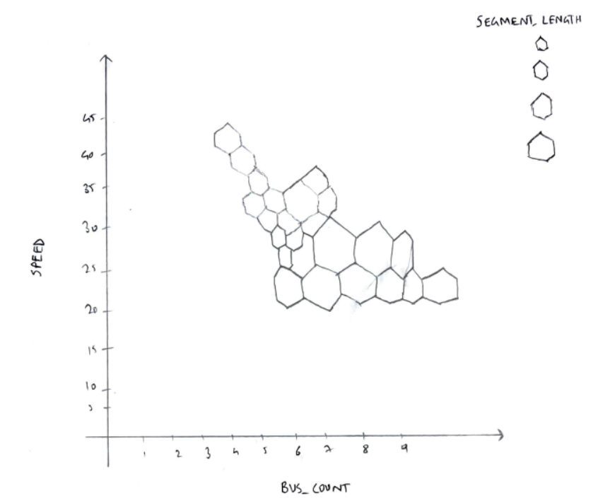
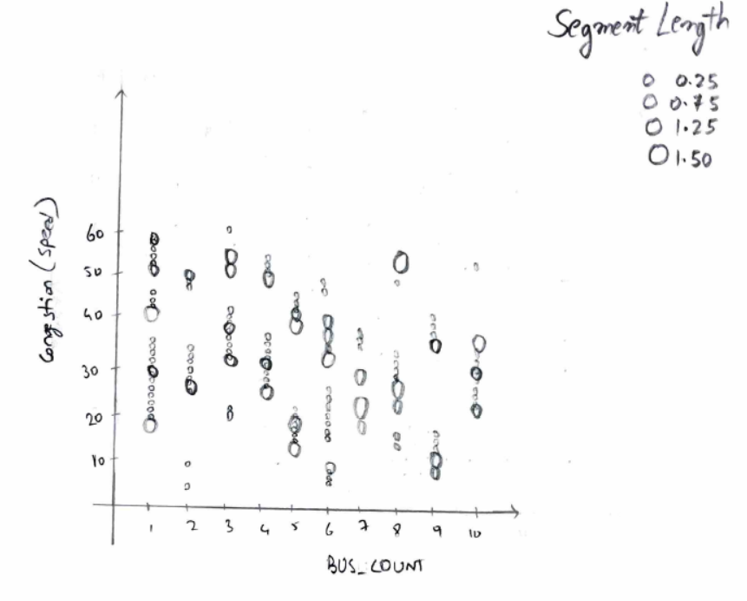
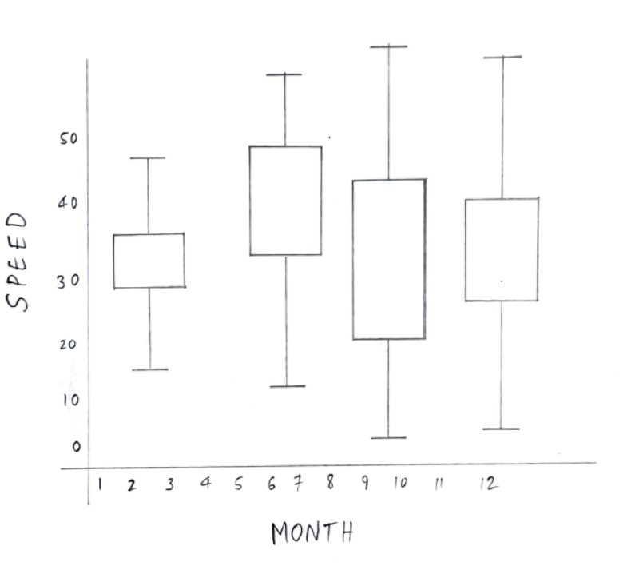
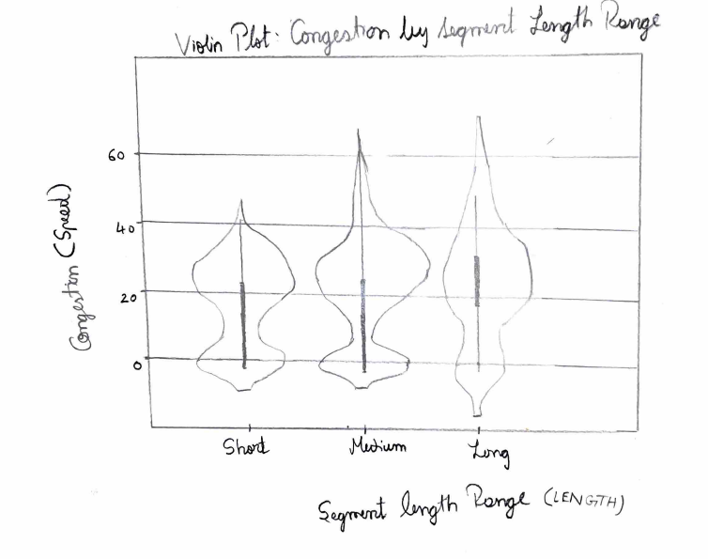
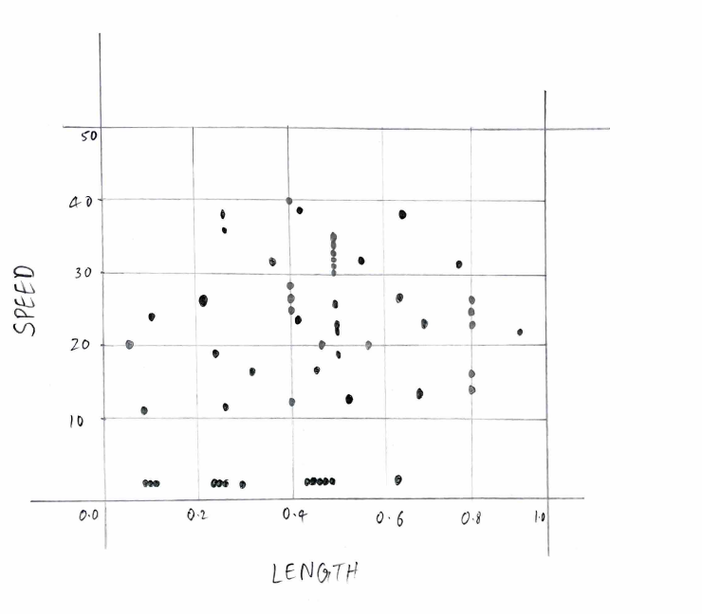
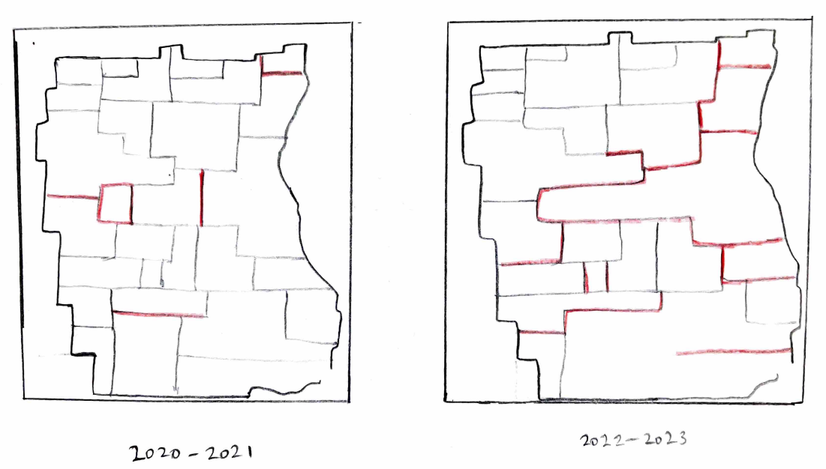
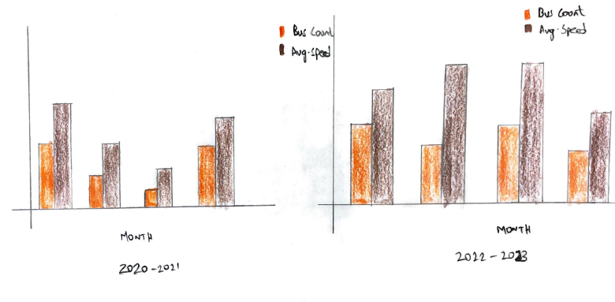
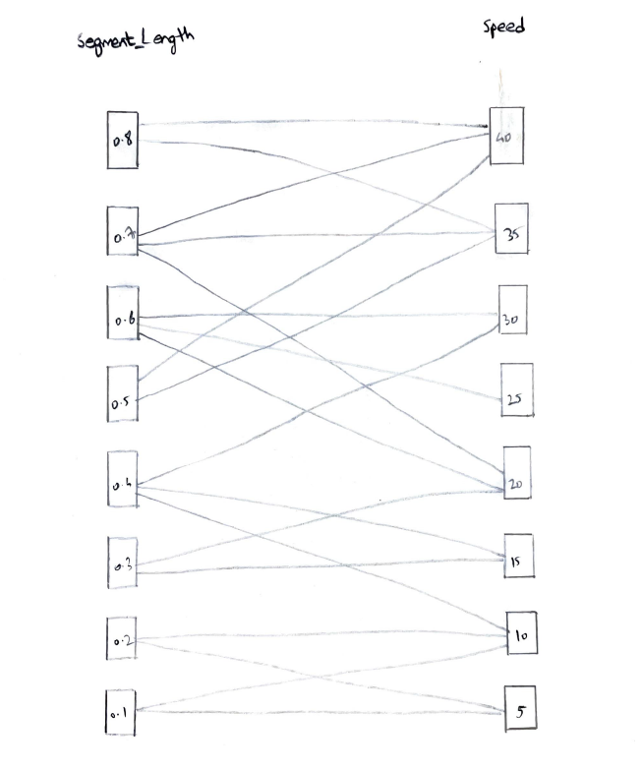
Sketches
We have used 17 sketches to answer 7 domain questions.

Slide 5
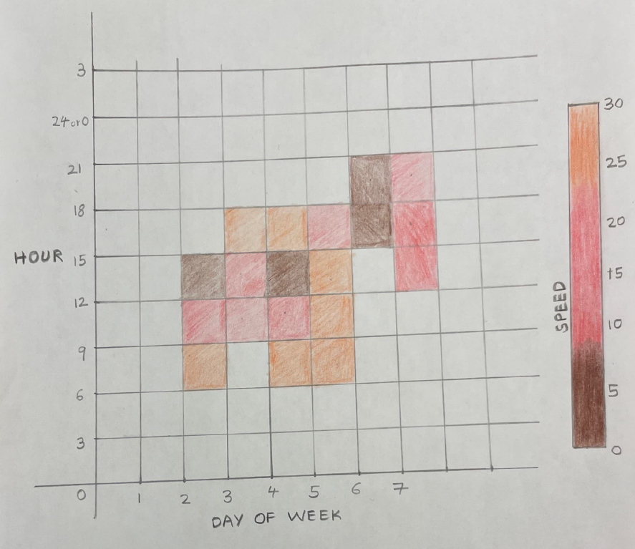
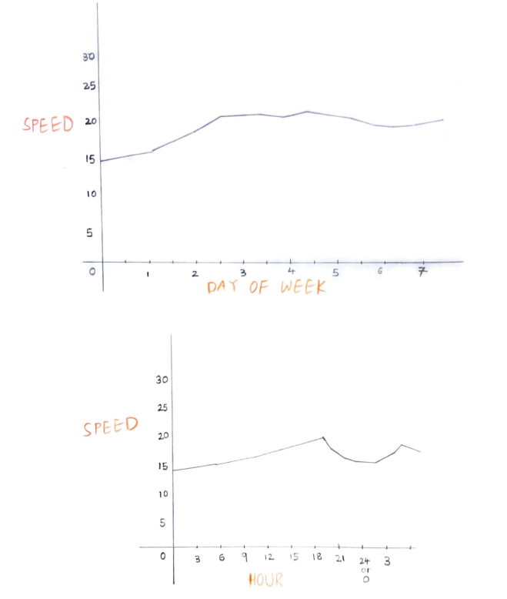
Domain Question 1: How does congestion vary by time of day and day of the week?
Heatmap of Congestion by Hour and Day
Reasoning behind design decision: The use of color intensity in Heatmaps used to represent congestion levels allows users to quickly identify peak congestion times.
Weekly Average Congestion Line Chart
Reasoning behind design decision: In this case, line chart help users understand weekly variations in congestion, enabling informed decision-making for commute planning.
Notes:
Heatmaps are ideal for representing complex temporal data.
Line charts are great for showing trends over time.

Slide 6
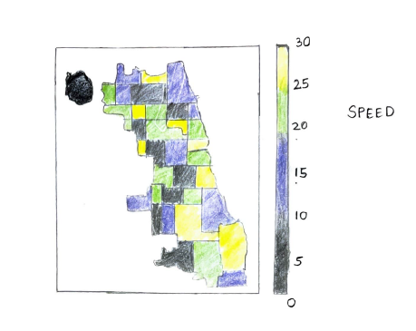
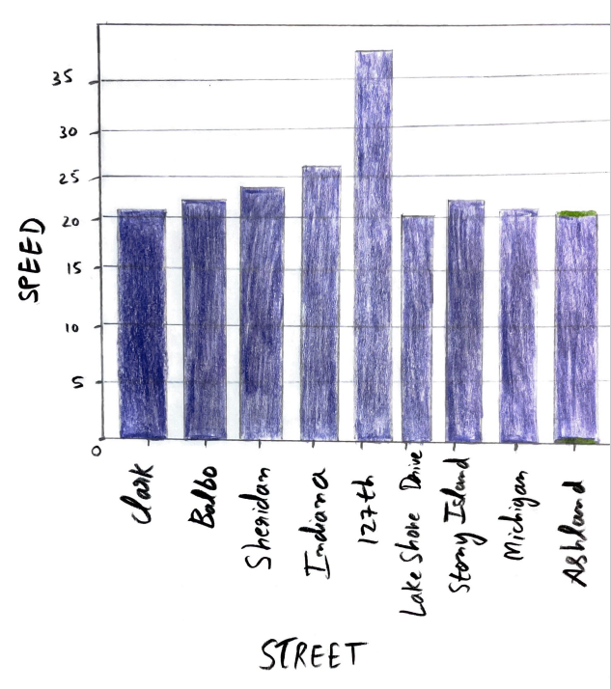
Domain Question 2 : Which arterial streets experience the worst congestion?
Choropleth Map of Congestion by Street
Reasoning behind design decision: By using color coding, we make it easy for users to pinpoint highly congested areas in Chicago using Choropleth.
Bar Chart
Reasoning behind design decision: Users can quickly identify which streets consistently experience high congestion, facilitating route planning.
Notes:
Choropleth maps are effective for spatial analysis
Bar charts are straightforward and perfect for making street-level comparisons.

Slide 7
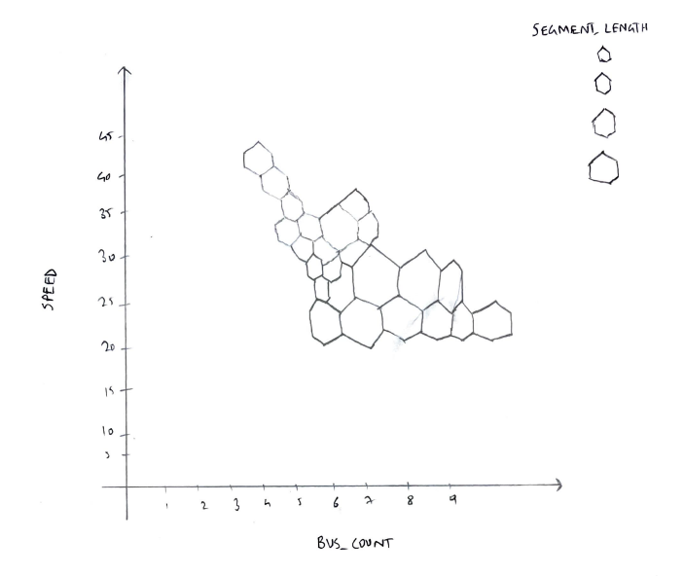
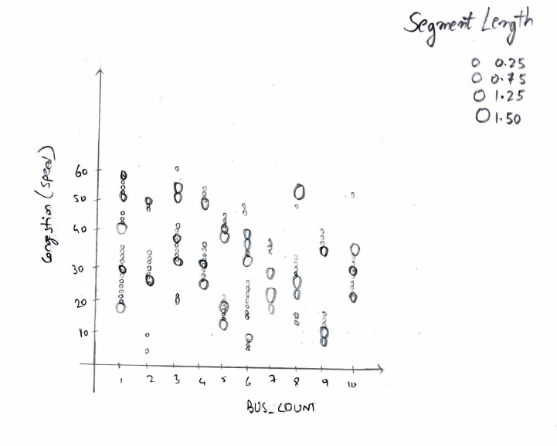
Domain Question 3 : What is the impact of bus count on congestion?
Hexbin Plot
Reasoning behind design decision: This design decision enables users to understand how bus count and congestion patterns are related, considering varying segment lengths.
Bubble Chart of Bus Count, Congestion & Segment Length
Reasoning behind design decision: This design decision allows users to grasp how bus count, congestion, and segment length are interrelated.
Notes:
Hexbin plots are effective for handling point density
Bubble charts can accommodate multiple variables.

Slide 8
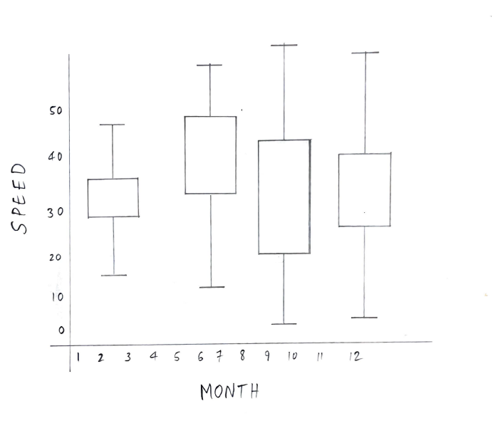
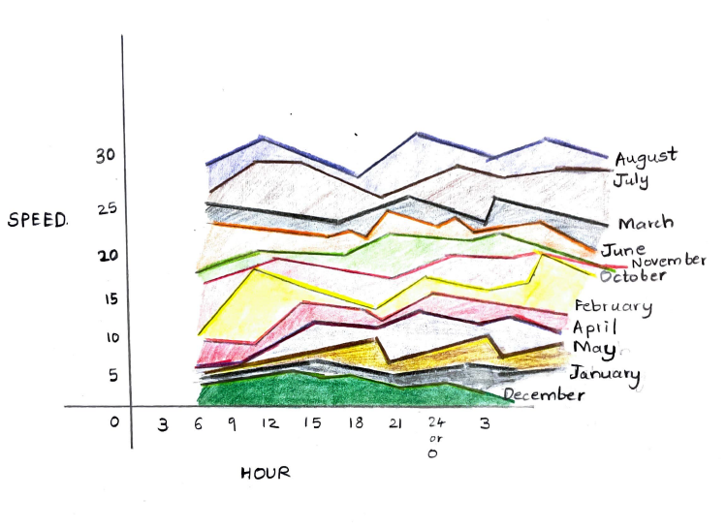
Domain Question 4 : What role does the weather play in congestion during Winters and Summers? Are there any trends in different months?
Box Plot of Monthly Congestion
Reasoning behind design decision: Users can quickly identify variations in congestion levels within each month, which is crucial for understanding seasonal patterns.
Seasonal Congestion Stacked Area Chart
Reasoning behind design decision: Using different colors to represent months, this design decision helps users compare congestion patterns between different months and grasp seasonality trends.
Notes:
Box plots are excellent for displaying data distributions.
Stacked area charts are adept at showing changes over time.

Slide 9


Domain Question 5 : Are there specific traffic segments that consistently experience high or low congestion?
Bar Chart of Top Congested Segments
Reasoning behind design decision: This design decision aids in identifying segments requiring traffic management or infrastructure improvements.
Bubble Chart
Reasoning behind design decision: This design decision helps users quickly identify congested segments and their respective congestion levels.
Notes:
Bar charts are straightforward and facilitate quick comparisons.
Bubble charts effectively convey multiple variables.

Slide 10


Domain Question 6 : What is the relationship between segment length (attribute: LENGTH) and traffic congestion?
Violin Plot
Reasoning behind design decision: Users can quickly understand how congestion levels vary within specific length ranges.
Scatter Plot
Reasoning behind design decision: This design decision helps users understand congestion patterns within varying segment lengths.
Notes:
Violin plots offer detailed insights into data distribution.
Scatter plots are excellent for visualizing relationships between continuous variables.

Slide 11


Domain Question 7 : How did the COVID-19 affect the traffic patterns in the city of Chicago?
Density Map
Reasoning behind design decision: The color gradient indicates congestion density, making it easy for viewers to identify areas with significant traffic pattern shifts.
Grouped Bar Chart
Reasoning behind design decision: The grouped bar chart is chosen as it effectively displays the before and after impact of COVID-19 on bus count and speed, offering a straightforward visual comparison for quick insights into how the pandemic influenced traffic patterns.
Notes:
A density map effectively represents spatial data changes and offers a clear before-and-after view of how the pandemic affected traffic congestion.

Slide 12
Exploratory Data Analysis
Total number of rows = 93,17,653
Total number of columns = 22
After removing NaN values number of rows = 11,30,044
Calculated percentage of missing values
Converted the 'TIME' column to a Date and Time columns
Dropped rows where SPEED is in negative values, in order to avoid wrong average speed calculation

Slide 13
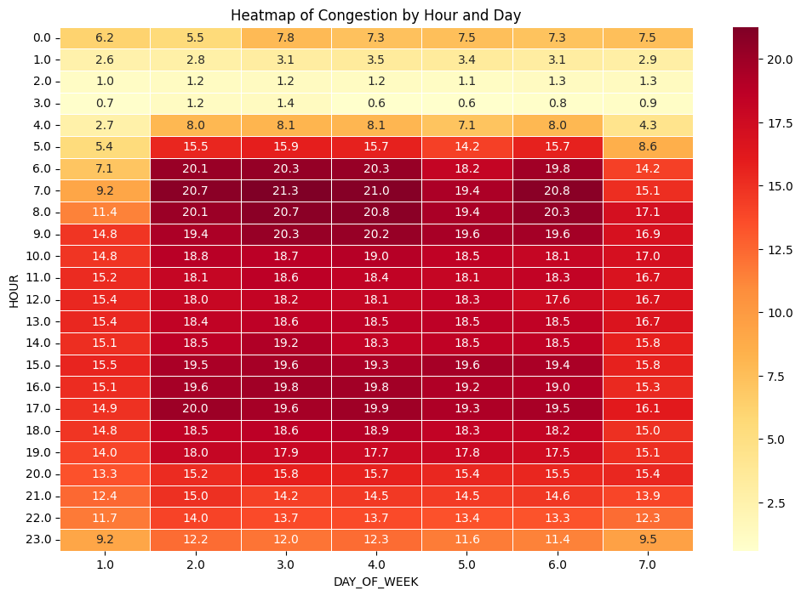
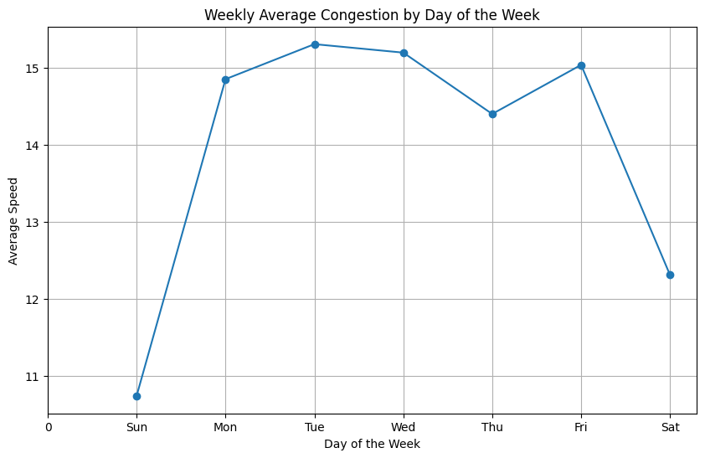
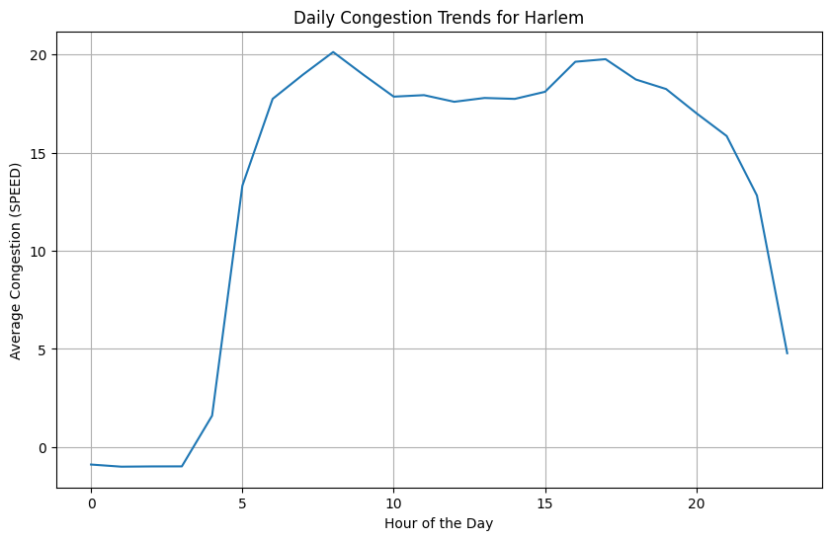
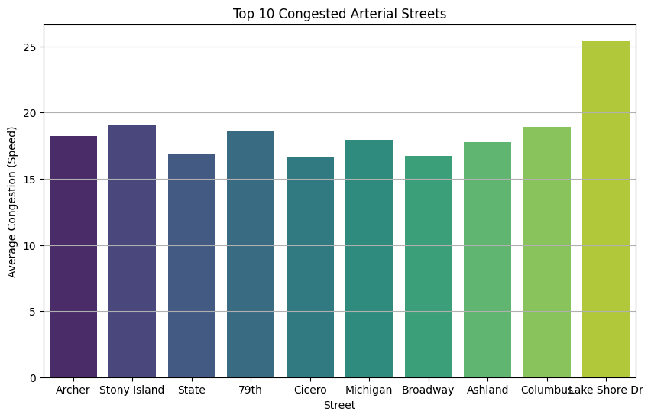
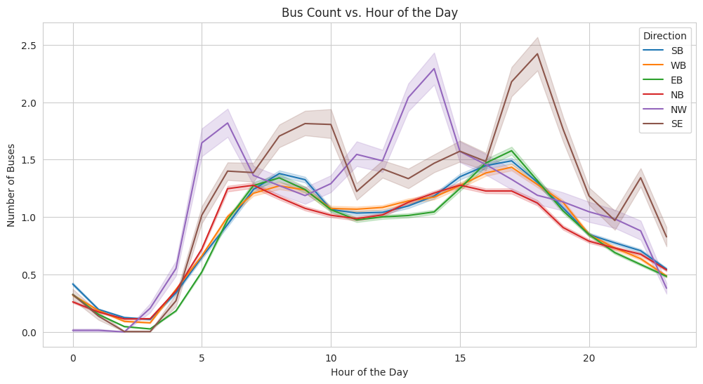
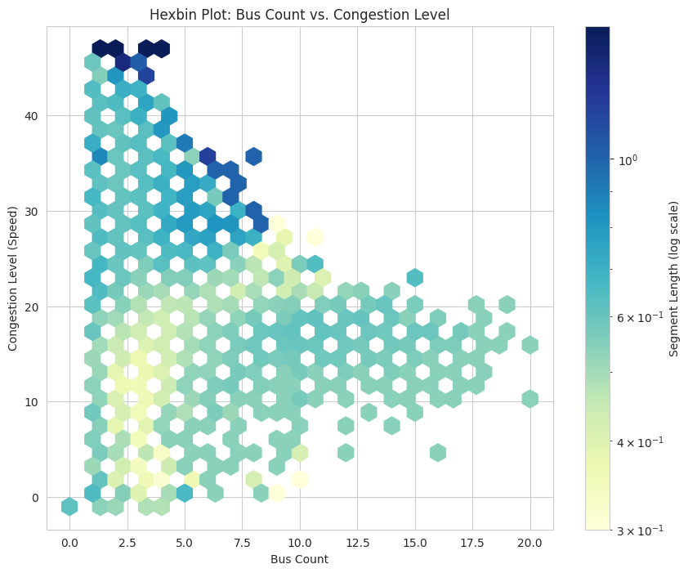
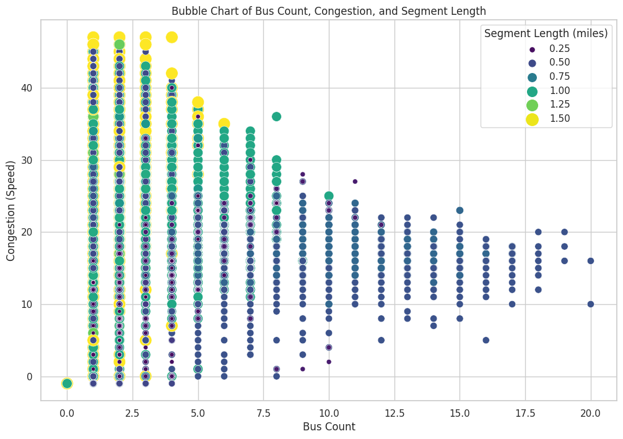
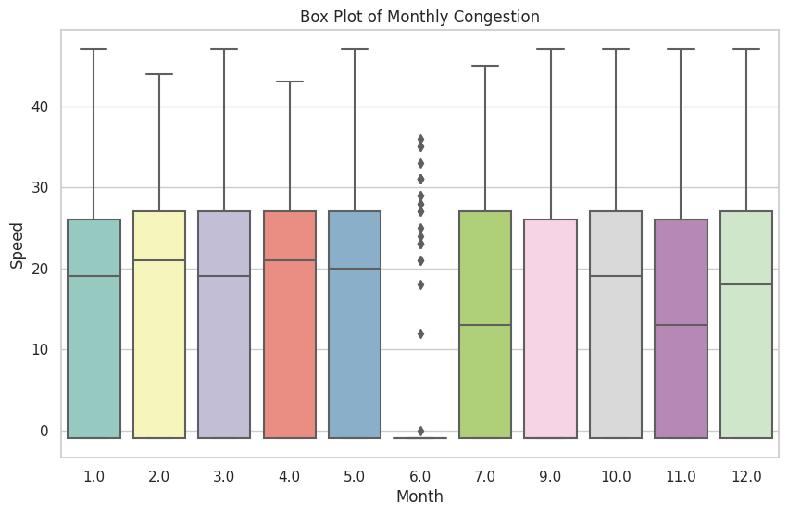
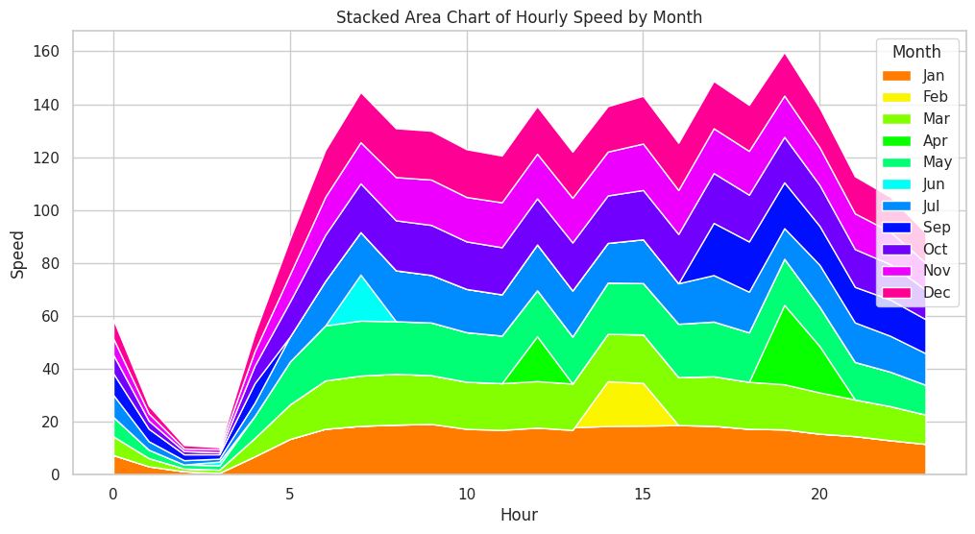
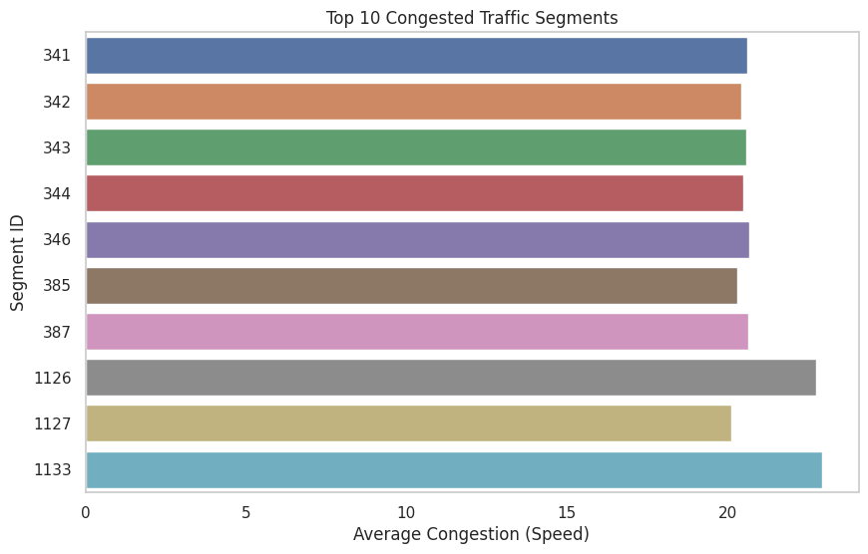
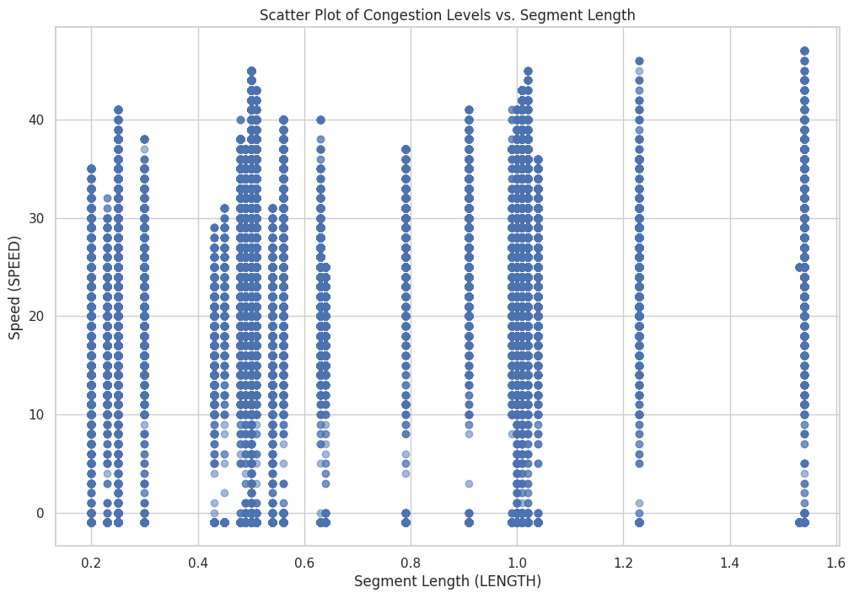
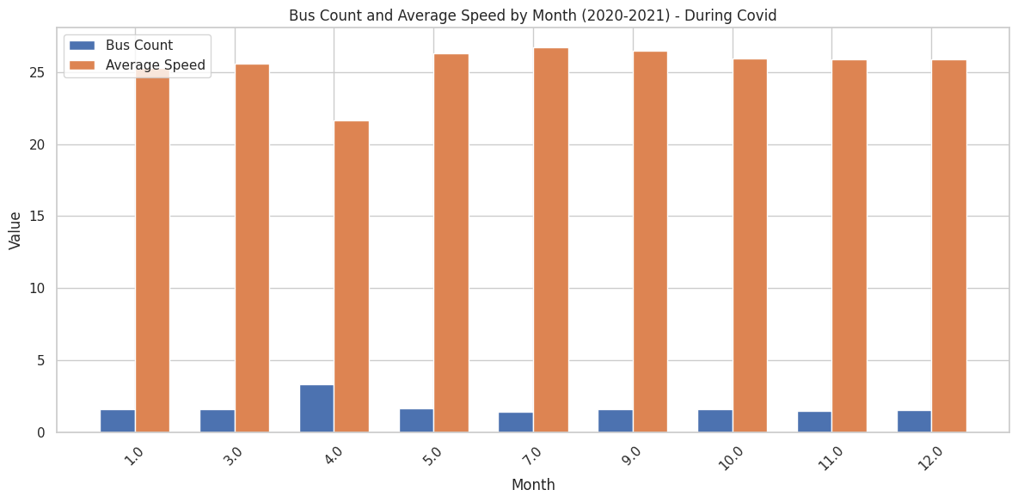
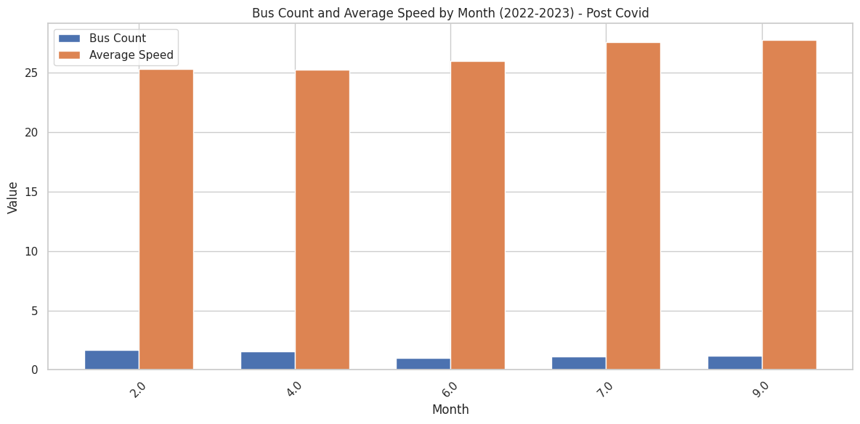
Visualizations
Based on the sketches, we were able to visualize 11 successfully. Also, we were able to visualize at least one for each domain question.

Slide 14

Domain Question 1: How does congestion vary by time of day and day of the week?
Visualization: A heatmap showcasing congestion patterns in Chicago by hour and day.
Reasoning behind design decision: The heatmap emerged from the need to analyze peak congestion hours and identify weekday vs. weekend patterns.
Visual encodings: Color intensity
Influence from Sketch: The heatmap design was influenced by the initial sketch, emphasizing color differentiation for congestion levels.
Heatmap of Congestion by Hour and Day
Notes:
Visual encodings: Color intensity is used to represent congestion levels, with darker colors indicating higher congestion. This choice enables quick comprehension of traffic patterns.

Slide 15

Domain Question 2: Which arterial streets experience the worst congestion?
Bar Chart of Top 10 Congested Arterial Streets
Visualization: A bar chart listing the top 10 congested arterial streets.
Reasoning: The bar chart was generated to pinpoint streets in need of immediate attention.
Visual encodings: Use of the 'viridis' Color Palette and bar length
Influence from Sketch: The sketch emphasized the need for simplicity and a clear ranking of congested streets.
Notes:
Visual encodings: Use of the 'viridis' Color Palette: Different shades of the same color palette enhance differentiation between streets.

Slide 16

Domain Question 3: What is the impact of bus count on congestion?
Hexbin Plot
Visualization: A hexbin plot revealing the relationship between bus count, congestion, and segment length.
Reasoning: The hexbin plot was created to understand the impact of segment length on congestion.
Visual encodings: Logarithmic Color Scale
Influence from Sketch: The sketch pointed out the necessity to represent data density and identify bus count's impact on congestion.
Notes:
Visual encodings: Logarithmic Color Scale: The use of a logarithmic color scale enhances visualization of segment length without oversaturating color.

Slide 17

Domain Question 4: What role does the weather play in congestion during Winters and Summers? Are there any trends in different months?
Visualization: A box plot showing congestion distribution for each month.
Reasoning: The box plot was chosen to highlight monthly variations in congestion levels.
Visual encodings: Box, Color and Whiskers
Influence from Sketch: The sketch emphasized the need for showcasing congestion patterns for each month.
Box Plot of Monthly Congestion
Notes:
Visual encodings: Highlighting Outliers: Outliers are presented as individual data points beyond the whiskers, drawing attention to exceptional cases.

Slide 18

Domain Question 5: Are there specific traffic segments that consistently experience high or low congestion?
Visualization: A bar chart listing top congested segments.
Reasoning: This chart allows for easy identification and prioritization of highly congested segments.
Visual encodings: Bar Length
Influence from Sketch: The sketch highlighted the necessity to identify and rank congested segments.
Bar Chart of Top Congested Segments

Slide 19

Domain Question 6: What is the relationship between segment length (attribute: LENGTH) and traffic congestion?
Scatter Plot
Visualization: A scatter plot depicting the relationship between segment length and congestion levels.
Reasoning: The scatter plot offers insights into how congestion levels vary across different segment lengths.
Visual encodings: Position (X and Y Coordinates)
Influence from Sketch: The sketch pointed out the importance of understanding congestion patterns in relation to segment length.

Slide 20
Domain Question 7: How did the COVID-19 affect the traffic patterns in the city of Chicago?
Grouped Bar Chart
Visualization: A grouped bar chart comparing bus count and average speed during COVID-19 and post-COVID periods.
Reasoning: The grouped bar chart aids in understanding bus count and speed fluctuations during and after the pandemic.
Visual encodings: Bar Color and Length
Influence from Sketch: The sketch emphasized the need for contrasting data during different periods.

Slide 21
Thank you

